Slide 1


NALAIYA THIRAN - Project Work
M.A.M. COLLEGE OF ENGINEERING AND TECHNOLOGY
Siruganur, Tiruchirappalli – 621 105.
Project Title : Efficient Water Quality Analysis & Prediction Using Machine Learning
Register Number | Name of Student
812019205005 | Banupriya K
812019205017 | Jeeva P
812019205018 | Keerthana M
812019205019 | Lathika R
812019205046 | Shanmugapriya M
Under the esteemed guidance of
Mentor Name & Designation: Mrs. B. Rama & ASP/ IT
Evaluator Name & Designation: Dr. K. Geetha & HOD/IT
Version: MAMCET_PR-1.1
Notes:
Notes for Teachers:
The Synopsis presentation should contain 1. Real life applications 2. Overview of the subject 3. PO’s CO’s of the course 4. Individual Units overview 5. Lesson Plan 6. Flip Class topics
“ Be professionally dressed and use a QUALITY PEN. Never hand an ordinary PEN as a Cosmetic Effect”

Slide 2
Problem Definition
Water is considered as a vital resource that affects various aspects of human health and lives.
The quality of water is a major concern for people living in urban areas.
The quality of water serves as a powerful environmental determinant and a foundation for the prevention and control of waterborne diseases.
However predicting the urban water quality is a challenging task since the water quality varies in urban spaces non-linearly and depends on multiple factors, such as meteorology, water usage patterns, and land uses, so this project aims at building a Machine Learning (ML) model to Predict Water Quality by considering all water quality standard indicators.

Slide 3
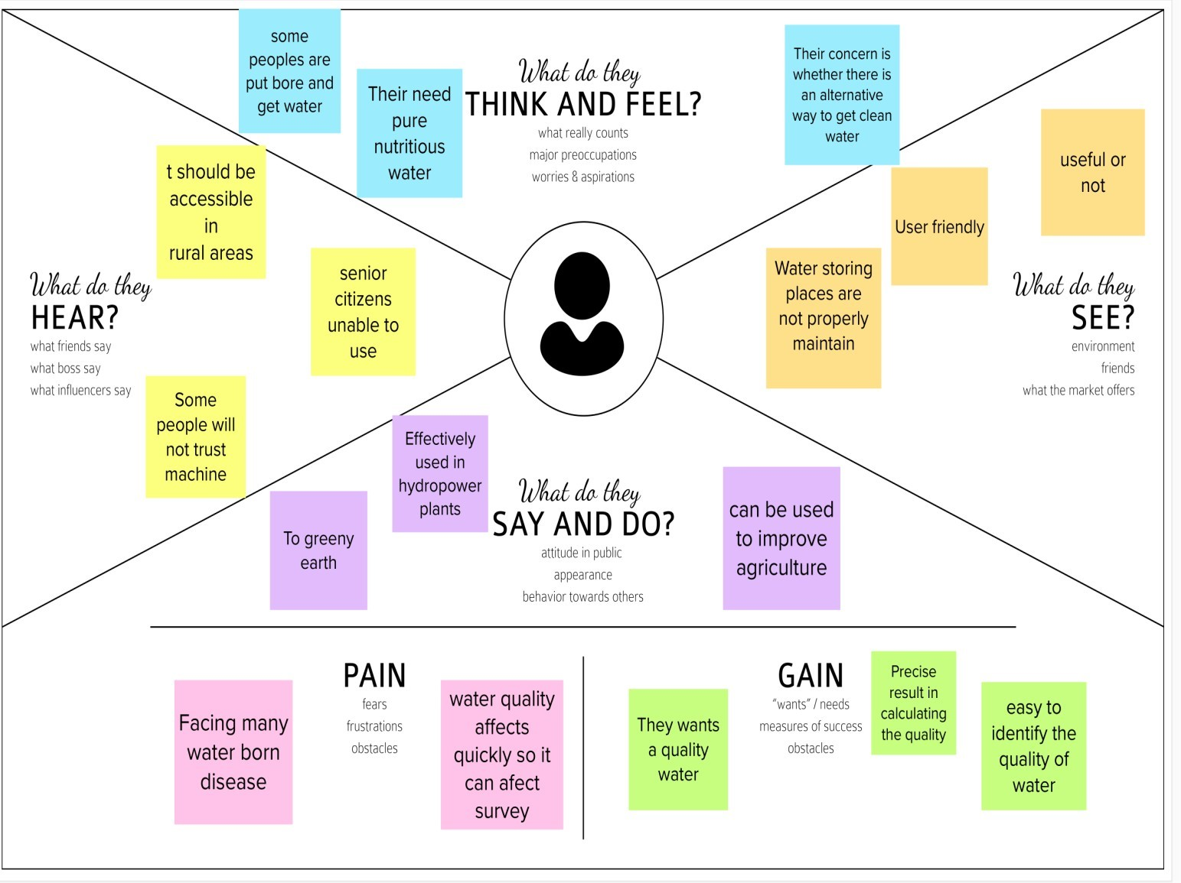
Empathise & Discover

Slide 4
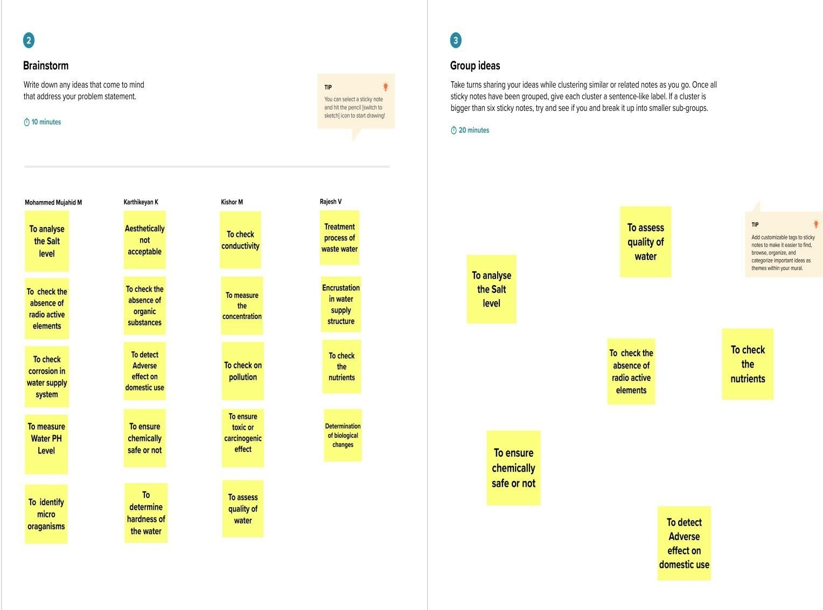
Brainstorming

Slide 5
Proposed solution
In this techniques our model processes that the water is safe to drink or not using some parameters like the value, conductivity, hardness, etc.,.
Access to safe drinking is essential to health a basic human right and a component of effective policy for health protection.

Slide 6
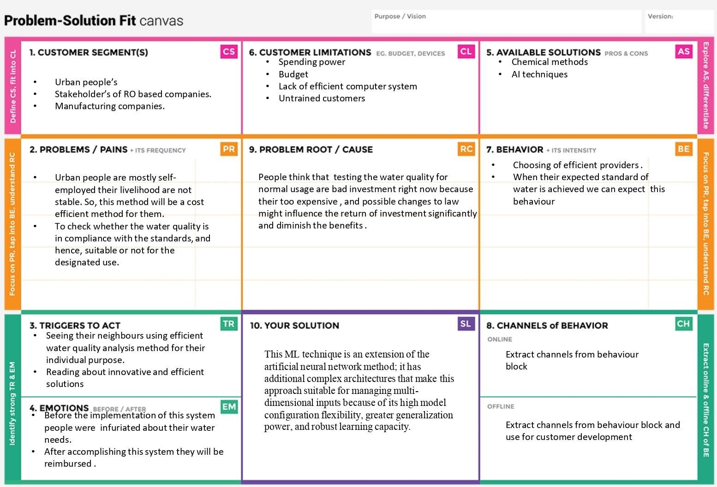
Problem solution fit

Slide 7
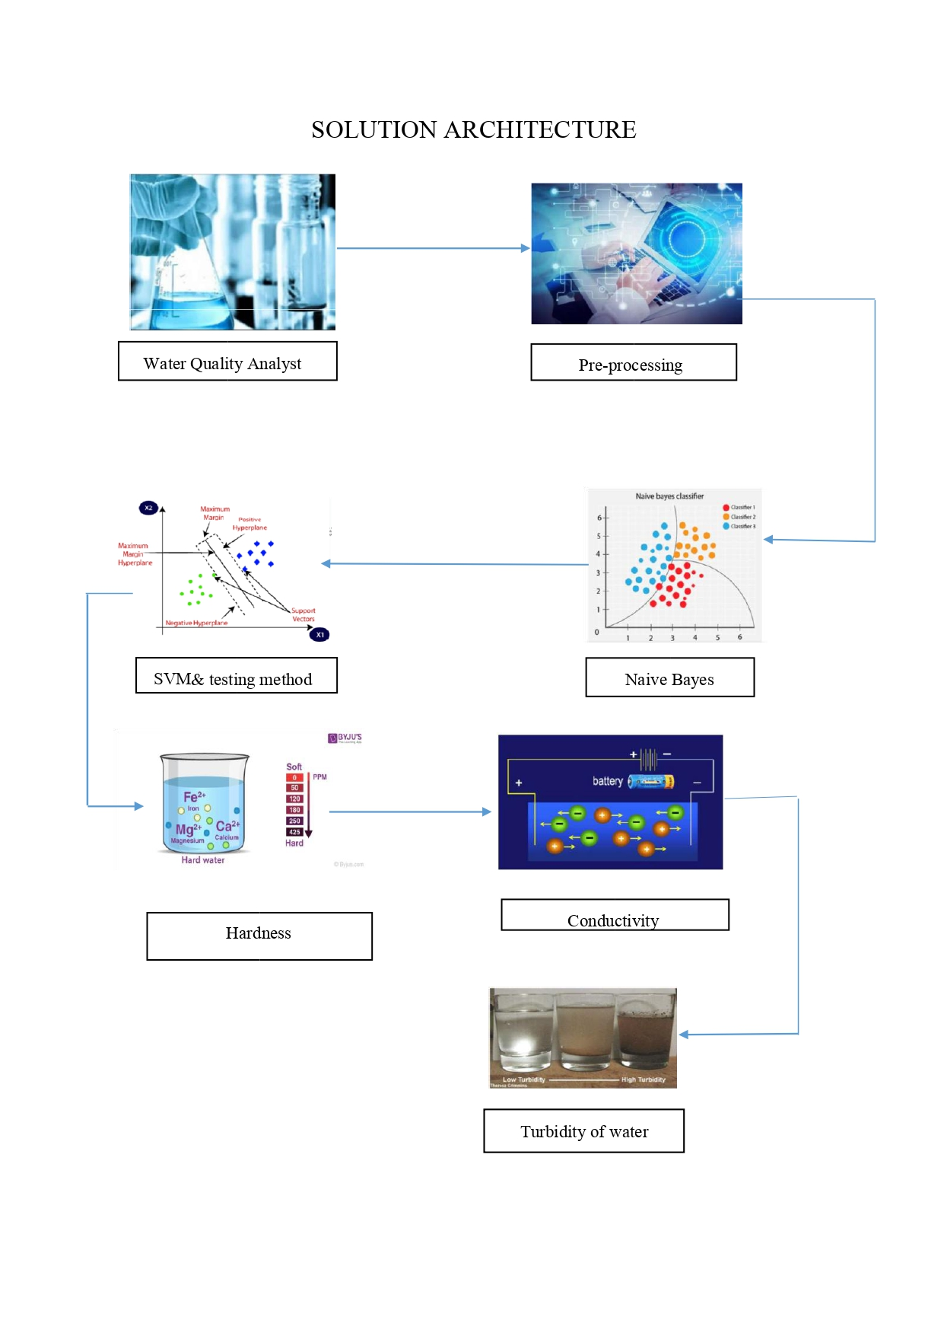
Solution Architecture

Slide 8
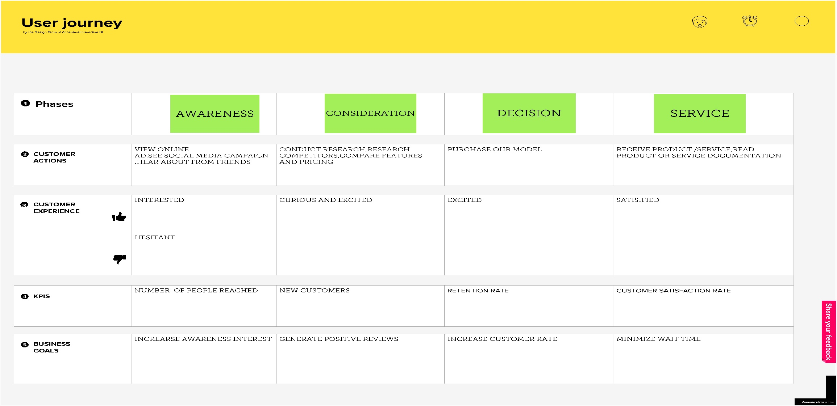
Customer Journey Map

Slide 9
Functional & Operational Requirements
FR NO | FUNCTIONAL REQUIREMENTS | DESCRIPTION
NFR-1 | User Form | User can able to predict the quality
NFR-1 | Executive Administration | Regulation of monitoring the water environment status like pollution , etc.,
lik NFR-1 | Data Handling | Files contains water quality metrics for different waterbodies
NFR-1 | Quality Analysis | Analysis with the acquired information of the water across various quality indicator
NFR-1 | Model Prediction | Confirmation based on water quality index and shows the machine learning prediction

Slide 10
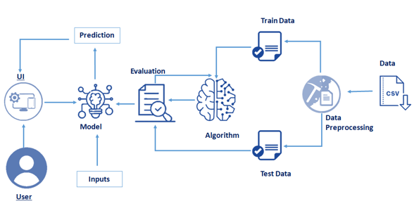
Technical Architecture

Slide 11
Open source Framework Used
Google Colab - Colaboratory, or “Colab” for short, is a product from Google Research. Colab allows anybody to write and execute arbitrary python code through the browser, and is especially well suited to machine learning, data analysis and education.
Anaconda- Aims to simplify the packaging management and deployment
Flask - It is a web frame work. Used to develop easy web application

Slide 12
Third Party API
Flask
Scikit Learn
IBM Watson Studio
Google Colab

Slide 13
Cloud Deployment
PUBLIC CLOUD:
Public clouds are the most common type of cloud computing deployment.
The cloud resources (like servers and storage) are owned and operated by a third-party cloud service provider and delivered over the internet.
With a public cloud, all hardware, software and other supporting infrastructure are owned and managed by the cloud provider.
For Our Project we are using IBM Cloud

Slide 14
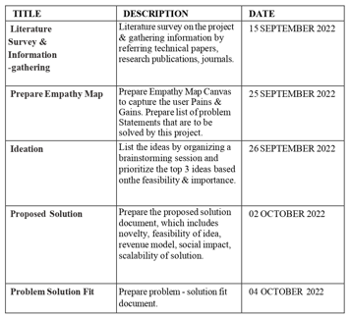
Project Milestone & Task

Slide 15

Sprint Delivery Plan

Slide 16
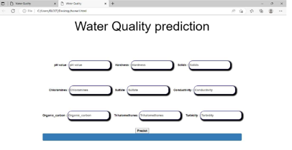
Coding & Solution

Slide 17
Acceptance Testing
Resolution | Severity 1 | Severity 2 | Severity 3 | Severity 4 | Subtotal
By Design | 7 | 4 | 2 | 3 | 17
Duplicate | 1 | 0 | 3 | 0 | 4
External | 2 | 3 | 0 | 1 | 6
Fixed | 10 | 2 | 4 | 15 | 31
Not Reproduced | 0 | 0 | 1 | 0 | 1
Skipped | 0 | 0 | 1 | 1 | 2
Won't Fix | 0 | 3 | 2 | 1 | 6
Totals | 20 | 12 | 13 | 21 | 66

Slide 18
Performance Metrics
The performance metrics are the accuracy of the model and the errors that the model is predicting.
The MAE (Mean Absolute Error), MSE (Mean Squared Error) and MSE (Root Mean Squared Error) are 0.9892681704260707, 5.557973864661655 and 2.3575355489709278 respectively.
The accuracy of the model is 96.97034933666699. These are the factors that determine the performance of the model.

Slide 19
Project Demonstration
Drive link of the Project Demonstration has to be included
https://drive.google.com/drive/folders/1rC1jLKYYh-vLm4qe307dVTkP8ahqx03n

Slide 20
Project Documentation
Drive link of the Project Documentation has to be included
https://workdrive.zohoexternal.com/writer/open/rl45i38978915ae304b72a09aff8f150911b1?authId=%7B%22linkId%22%3A%225k2wApabOpc-LYmlU%22%7D

Slide 21
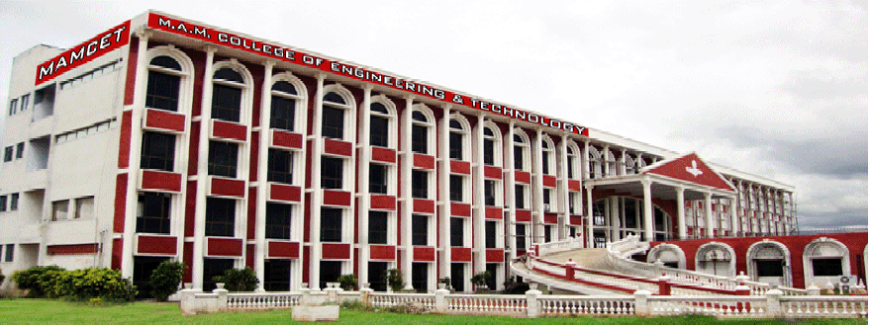
Thank You Slide

